Slide 1
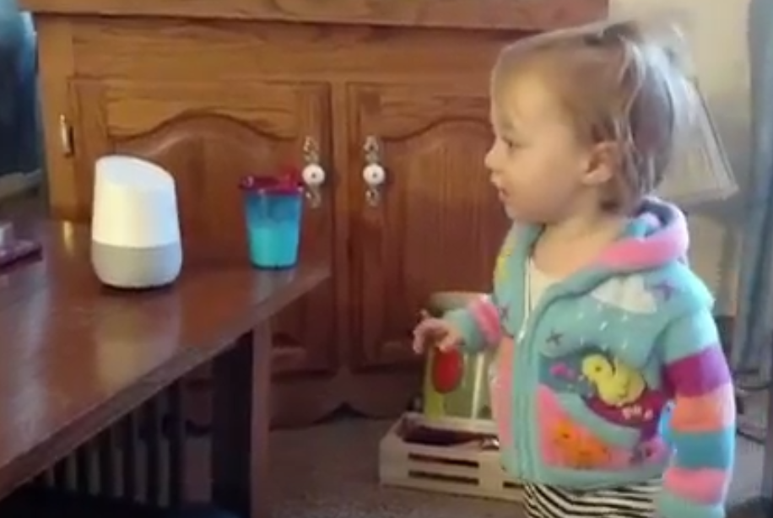
NLP and Transformers: Machine Learning for NLP
Jay Urbain, PhD
jay.urbain@gmail.com
https://www.linkedin.com/in/jayurbain/
https://github.com/jayurbain
March 2022

Slide 2
Part 1:
What is NLP?
Problem Formulation
Text Representations
Dimensionality Reduction
Embeddings
RNNs
“Attention is All You Need”
Part 2:
Transformer Architecture
BERT Model
Pretraining BERT
TOPICS

Slide 3
APPLICATIONS

Slide 4
Automatic Writing
NLP TASKS
General Q&A
Intent Detection
Summary Generation
Common Sense Reasoning
Natural Language Processing
Word Sense
Auto Completion
Automatic Dialogue Generation
Translation
Sentiment Analysis
Code Generation
And many more….

Slide 5
ML for NLP: PROBLEM FORMULATION

Slide 6
Machine Learning
Discovering structures in text
?
Machine Learning Algorithm
Text

Slide 7
Machine Learning
ML for NLP
Subset of Problem formulations
Machine Learning Algorithm
Text Pre-processing
Text Representation
Reweighting
Dimensionality Reduction
Vector Comparison
Text
Text representation
NLP Task
Subset of
approaches
Subset of word representations

Slide 8
TEXT REPRESENTATIONS

Slide 9
Text Representations
The bag of words
Bag of words/ngrams – feature per word/ngram
the cat sat on the mat
Various ways of choosing the values: Binary, Count, TF-IDF
… |Vocabulary|
cat | sat | on | the | mat | quickly
1 | 1 | 1 | 2 | 1 | 0

Slide 10
The Bag of words
Challenges with encoding BoW using One-hot encoding
Sparse Input (1-hot)
No semantic generalization
dog: 1 0 0 0 0 … 0
cat: 0 0 1 0 0 … 0
puppy: 0 0 0 0 1 … 0
p >> n (overfitting!)
…
…
…
Word 1
Word n
lots of data required,
low accuracy
Notes:
There are several issues with the BoW representation:
Sparse Input – As we saw in the previous example, each word is a feature. Hence, when providing this data to a model, we need to let it know that we mean feature number 1 in the BoW table which is cat, and not feature number 2 which is dog. We do this by performing a 1-hot encoding on the numbers: we create a vector with the size of the entire vocabulary. We then give the index we want the value 1 while all others are given the value 0. So cat will be the vector (1,0,0,…,|V|), dog will be (0,1,0,0,…,|V|), etc. For a large vocabulary (i.e., |V| is large) this means that much of the input data will be sparse – that is, have the value 0. The impact of sparseness is that the number of features (words) will potentially be much larger than the number of examples we have which will almost certainly lead to overfitting.
No semantic generalization – In this example, dog is feature #1 while cat is #2. Note that this is completely arbitrary. In particular, this means that we cannot generalize. In other words, the model is unable to apply knowledge that it learned about cats to dogs as it is completely unaware that the two are related (both are animals, have 4 legs and a tail, etc.). Ideally we would have liked a model that deals with animals to understand the similarities as well as the differences between animals before it dealt with our specific task. Putting it somewhat figuratively, we would have liked the model to show some innate intelligence.

Slide 11
DISTRIBUTED WORD REPRESENTATIONS

Slide 12
Distributional Hypothesis
The intuition – MEANING ~ CONTEXT
‘You can tell a word by the company it keeps’
Firth 1957
‘Distributional statements can cover all of the material of a language without requiring support from other types of information’
Harris 1954
‘The meaning of a word is its use in the language’
Wittgenstein 1953
‘The complete meaning of a word is always contextual, and no study of meaning apart from context can be taken seriously.’
Firth 1957

Slide 13
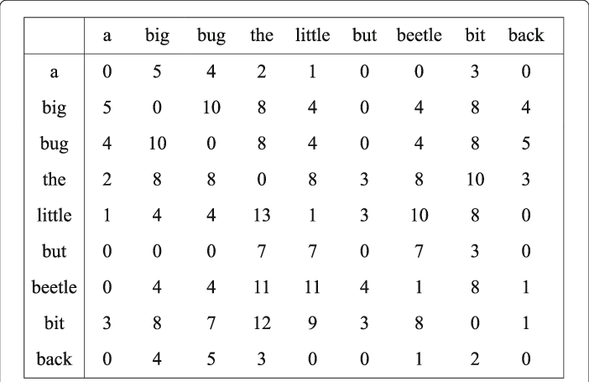
Co-occurrence patterns
Capture latent information using word co-occurrence

Slide 14
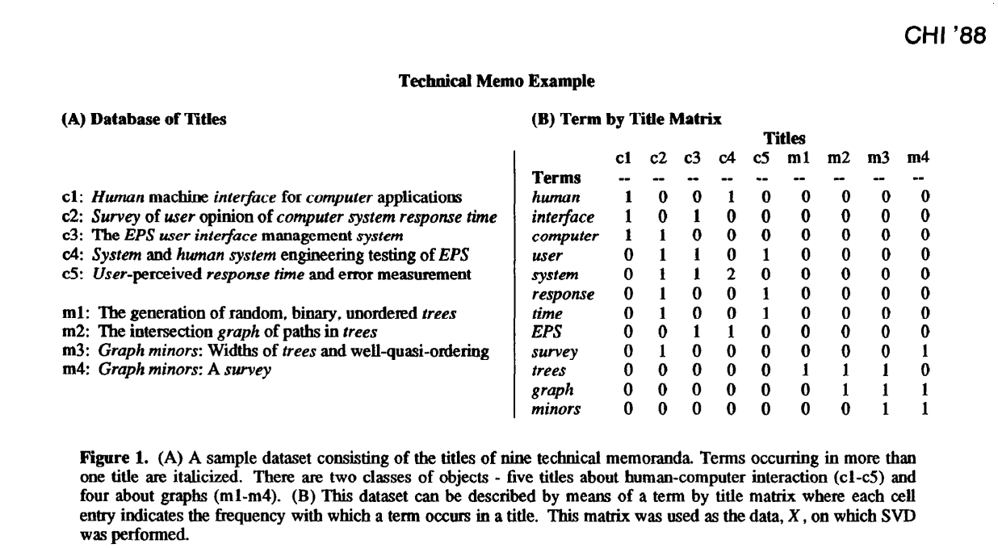
Co-occurrence patterns
Where to find latent relationships?
Possible relationships:
Word to documents (very sparse and very wide)
Word to word (very dense and compact)
Word to user / person
Word to user behaviour
Word to product
Word to custom feature (e.g. movie raking)
Not only metrices:
Word to user to product

Slide 15
Dimensionality Reduction
Need more robust and flexible representations
The need for compact and computationally efficient representations.
More robust notions of distance exposing the information captured by our distributional representation.

Slide 16
Latent Semantic Analysis / Latent Semantic Indexing

Slide 17
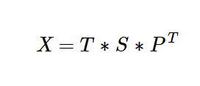
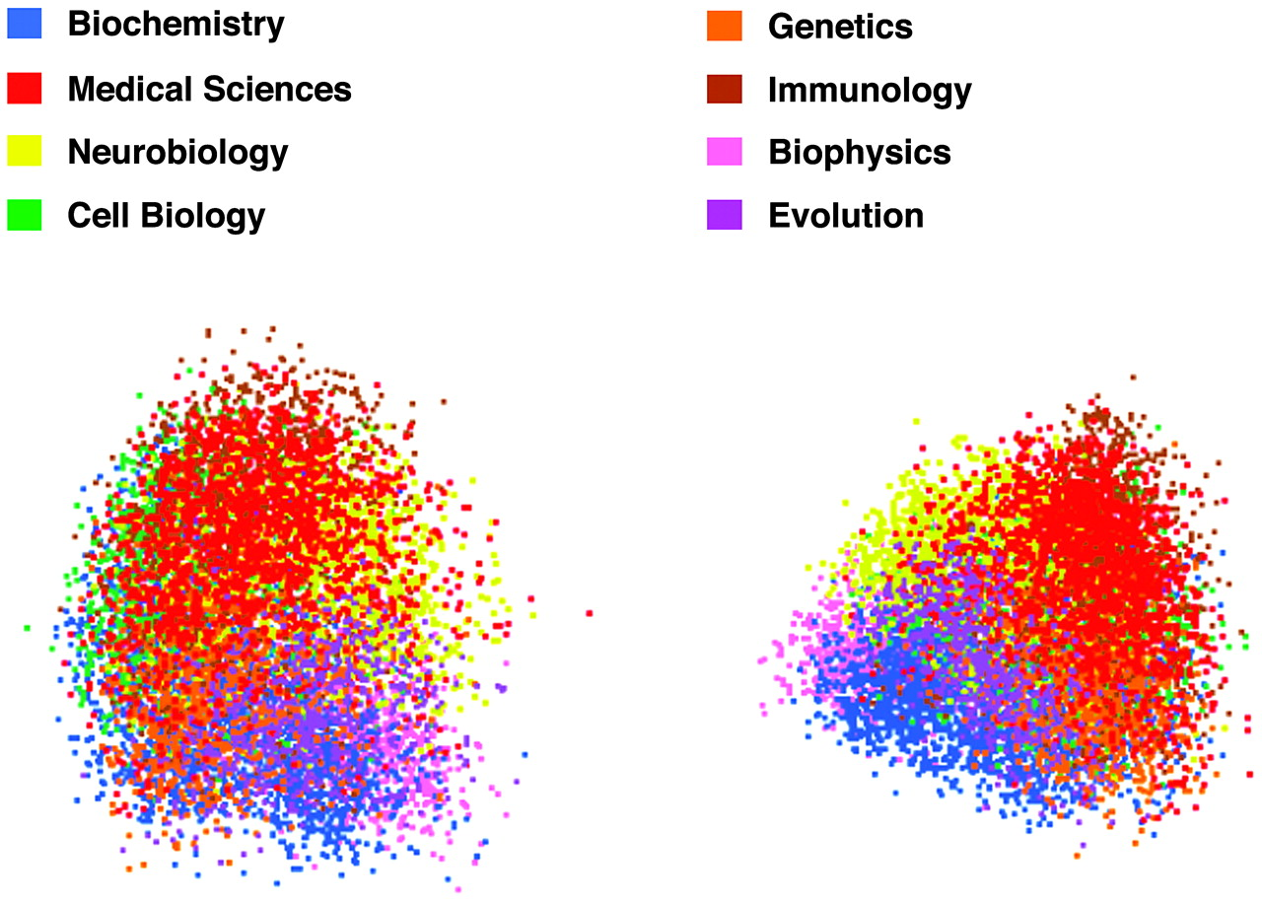
LSA/LSI
LSA/LSI - Documents that are similar are closer - SVD
Landauer, Thomas K., Darrell Laham, and Marcia Derr. "From paragraph to graph: Latent semantic analysis for information visualization." Proceedings of the National Academy of Sciences 101.suppl 1 (2004): 5214-5219.
Notes:
the singular value decomposition (SVD) is a factorization of a real or complex matrix. It generalizes the eigendecomposition of a square normal matrix with an orthonormal eigenbasis to any {\displaystyle m\times n} matrix. It is related to the polar decomposition.

Slide 18
ML Approaches for Word Representations

Slide 19
Status as of 2010
Machine Learning Methods
Clustering Based Representations
Brown Clustering
HMM-LDA
CRF Chunker with HMM
…
Distributional Representations
LSA / LSI
pLSA
LDA
HAL
ICA
Random Indexing
…
Distributed Representations
Collobert and Weston embeddings
HLBL embeddings
…
It was not clear that you can combine unsupervised approaches
(i.e., embeddings) with supervised models
Machine Learning Algorithm
Unsupervised embedding
Text
Turian, Joseph, Lev Ratinov, and Yoshua Bengio. "Word representations: a simple and general method for semi-supervised learning." Proceedings of the 48th annual meeting of the association for computational linguistics. 2010.

Slide 20
Neural Networks

Slide 21
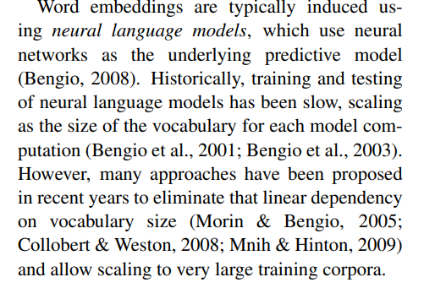
Status as of 2010
Not enough computational power
Turian, Joseph, Lev Ratinov, and Yoshua Bengio. "Word representations: a simple and general method for semi-supervised learning." Proceedings of the 48th annual meeting of the association for computational linguistics. 2010.

Slide 22
Word2Vec
Word2Vec
Mikolov et al., 2013 (while at Google)
Linear model (trains quickly)
Two models for training embeddings in an unsupervised manner:
Continuous Bag-of-Words (CBOW)
Skip-Gram
cat
PAD
the
sat
on
1-hot (|V|)
1-hot (|V|)
d-dimensional
Σ
d-dimensional
d-dimensional
E
E
E
E
E
E
E
E
d-dimensional
1-hot (|V|)
1-hot (|V|)
cat
cat
cat
cat
PAD
the
sat
on
Notes:
The main question now is how to implement an algorithm that generates word embeddings. There are multiple such algorithms. In this lab, you will work primarily with the Word2Vec algorithm that was invented by Mikolov et al. while at Google.
Word2Vec has two variants:
Continuous Bag-of-Words (CBOW): In this variant, using a number of context words, we try to predict the target word. Notice that by summing the embedding vectors we lose the word order, hence the BoW name.
Skip-Gram: In this variant we use the target word to predict each of the context words.
Note the words marked PAD – these are padding markers, signifying that there are no actual words here. Essentially, these are NULL markers for denoting empty context words.
A key property of the Word2Vec algorithm is that it is unsupervised (or more precisely, self-supervised). This means that it can be trained with huge corpora and generate very useful embedding vectors.

Slide 23
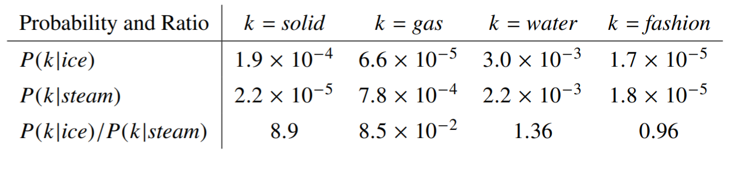
Glove
The objective
To learn vectors for words such that their dot product is proportional to their probability of co-occurence
Pennington, J., Socher, R., & Manning, C. D. (2014, October). Glove: Global vectors for word representation. In Proceedings of the 2014 conference on empirical methods in natural language processing (EMNLP) (pp. 1532-1543).
Notes:
The main question now is how to implement an algorithm that generates word embeddings. There are multiple such algorithms. In this lab, you will work primarily with the Word2Vec algorithm that was invented by Mikolov et al. while at Google.
Word2Vec has two variants:
Continuous Bag-of-Words (CBOW): In this variant, using a number of context words, we try to predict the target word. Notice that by summing the embedding vectors we lose the word order, hence the BoW name.
Skip-Gram: In this variant we use the target word to predict each of the context words.
Note the words marked PAD – these are padding markers, signifying that there are no actual words here. Essentially, these are NULL markers for denoting empty context words.
A key property of the Word2Vec algorithm is that it is unsupervised (or more precisely, self-supervised). This means that it can be trained with huge corpora and generate very useful embedding vectors.

Slide 24
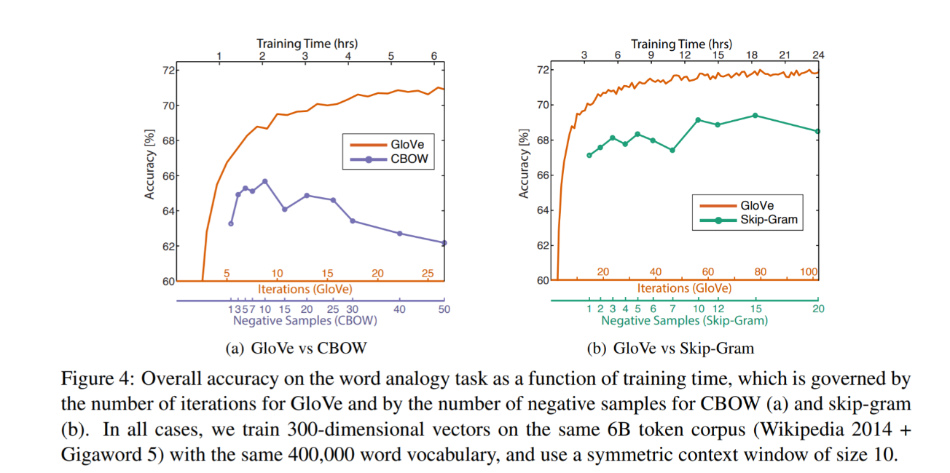
Glove
The objective
Pennington, J., Socher, R., & Manning, C. D. (2014, October). Glove: Global vectors for word representation. In Proceedings of the 2014 conference on empirical methods in natural language processing (EMNLP) (pp. 1532-1543).
Notes:
The main question now is how to implement an algorithm that generates word embeddings. There are multiple such algorithms. In this lab, you will work primarily with the Word2Vec algorithm that was invented by Mikolov et al. while at Google.
Word2Vec has two variants:
Continuous Bag-of-Words (CBOW): In this variant, using a number of context words, we try to predict the target word. Notice that by summing the embedding vectors we lose the word order, hence the BoW name.
Skip-Gram: In this variant we use the target word to predict each of the context words.
Note the words marked PAD – these are padding markers, signifying that there are no actual words here. Essentially, these are NULL markers for denoting empty context words.
A key property of the Word2Vec algorithm is that it is unsupervised (or more precisely, self-supervised). This means that it can be trained with huge corpora and generate very useful embedding vectors.

Slide 25
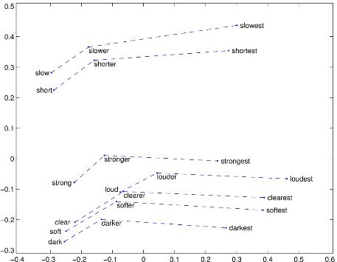
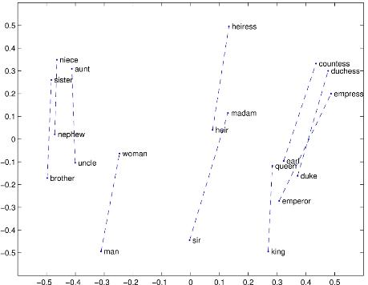
Glove
Properties
Comparative - Superlative
Man - Woman
Pennington, J., Socher, R., & Manning, C. D. (2014, October). Glove: Global vectors for word representation. In Proceedings of the 2014 conference on empirical methods in natural language processing (EMNLP) (pp. 1532-1543).

Slide 26
Glove
Not a distant past
Pennington, J., Socher, R., & Manning, C. D. (2014, October). Glove: Global vectors for word representation. In Proceedings of the 2014 conference on empirical methods in natural language processing (EMNLP) (pp. 1532-1543).

Slide 27
Using the embeddings
Notes:
To put it in perspective

Slide 28
THE Approach to NLP
Unsupervised feature representation + Machine Learning models
Subset of Problem formulations
Machine Learning Algorithm
Text Pre-processing
Text Representation
Reweighting
Dimensionality Reduction
Vector Comparison
Text
Subset of
approaches
Subset of word representations

Slide 29
THE Approach to NLP
What ML model to choose
Subset of Problem formulations
?
Machine Learning Algorithm
Text Pre-processing
Text Representation
Reweighting
Dimensionality Reduction
Vector Comparison
Text
Subset of
approaches
Subset of word representations

Slide 30
Classical approaches
Notes:
To put it in perspective

Slide 31

Classical Approaches
Very broad selection of tools

Slide 32
What about Feature Engineering?
Notes:
Are classical models able to solve complex problems without additional feature engineering? Distributional approaches only capture information about co-occurance

Slide 33
Deep Representation Learning

Slide 34
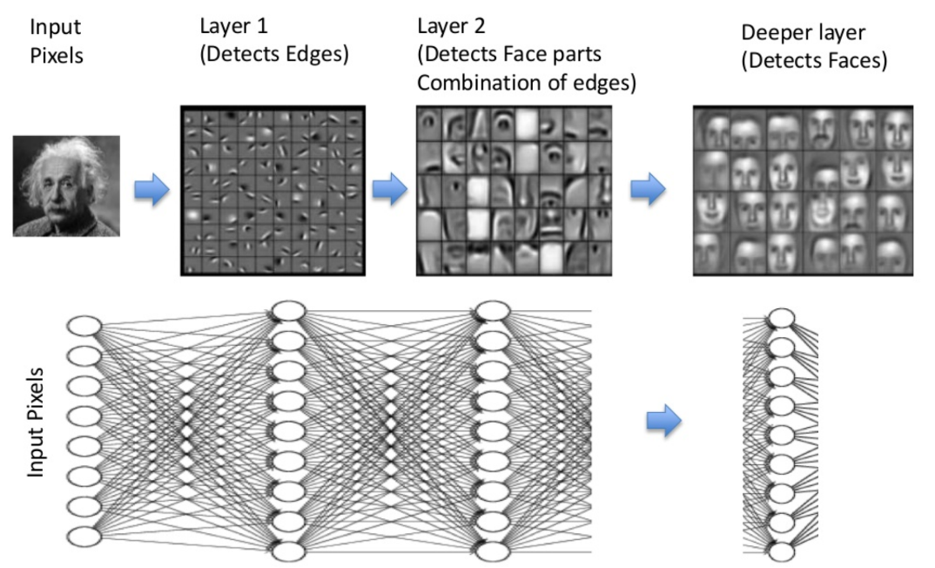
Deep Representation Learning
Beyond distributional hypothesis

Slide 35
Part 1: Machine Learning in NLP
Lecture
What is NLP?
Problem Formulation
Text Representations
Dimensionality Reduction
Embeddings
RNNs
“Attention is All You Need”
Lab
Transformer Architecture
BERT Model
Pretraining BERT
Notes:
In this part, there will both a lecture and a hands-on lab section. In the lecture we’ll cover these topics. The goal of this lecture is to provide a good overview of NLP tasks, and the technologies to date (briefly) that have led us to the Transformer architecture, which was presented in the now-famous Google paper, “Attention is All You Need”.

Slide 36
Recurrent Neural Networks
Basic principles
y
y_{t-1}
y_{t}
y_{t+1}
y_{t+2}
s
s_{t-1}
s_{t}
s_{t+1}
s_{t+2}
x
x_{t-1}
x_{t}
x_{t+1}
x_{t+2}
Unrolling in Time
Notes:
In the previous lab, we encountered Fully-Connected (FC) neural networks. We would either go forward (from layer i to i+1) when propagating information or backwards (from layer i+1 to i) when propagating the error. At no point did we go in a horizontal direction inside the same layer.
Often we wish to use neural networks with sequence inputs or outputs: in other words, our input/output consists of different values at different timesteps. For that, we need to use recurrent neural networks (RNNs). As shown in the example here, at each timestep we have different inputs (the X’s) and different outputs (the y’s). Additionally, we have the state from the previous timestep (the S’s) as input (with the initial state typically being the 0 vector).
The algorithm used to train RNN’s is just the usual backpropagation, applied to subsequent timesteps and hence known as Backpropagation-Through-Time (BPTT).

Slide 37
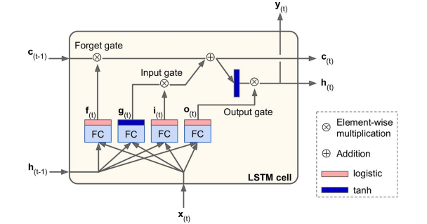
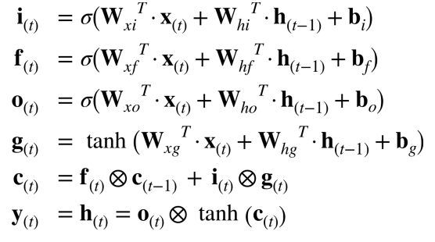
Long Short Term (LSTM) Cell
Addressing problems of stability
Notes:
Regular RNN’s are notoriously difficult to train. Because of the multiple timesteps, error gradients often tend to either shrink (‘vanish’) or grow (‘explode’) exponentially. This means that vanilla RNNs have difficulty with long sequences such as the ones we need for dealing with long text sequences.
A modification to the standard RNN is the Long Short-Term Memory (LSTM) cell, which overcomes many of the issues just mentioned. Essentially, it is a set of multiple neurons known as gates along with a memory cell. At each timestep, the cell receives input (x) along with the cell contents (c) and hidden state (h) from the previous timestep. The gates have the following functions:
Forget gate – what parts of the memory cell should be ‘forgotten’
Input gate – what parts of the input should be applied to the memory cell
Output gate - what parts of the memory cell should be exposed in the output of the cell
The new hidden state and memory cell state are then propagated to the next time step. The parameters are learned as usual using BPTT.

Slide 38
CNNs
Notes:
To put it in perspective

Slide 39
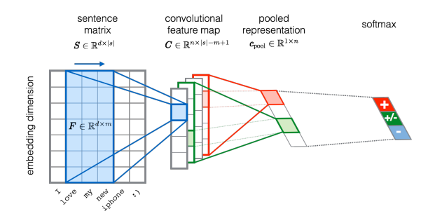
Convolutional Neural Networks
Basic principles
Severyn, Aliaksei, and Alessandro Moschitti. "Unitn: Training deep convolutional neural network for twitter sentiment classification." Proceedings of the 9th international workshop on semantic evaluation (SemEval 2015). 2015.

Slide 40
Attention
Notes:
To put it in perspective

Slide 41
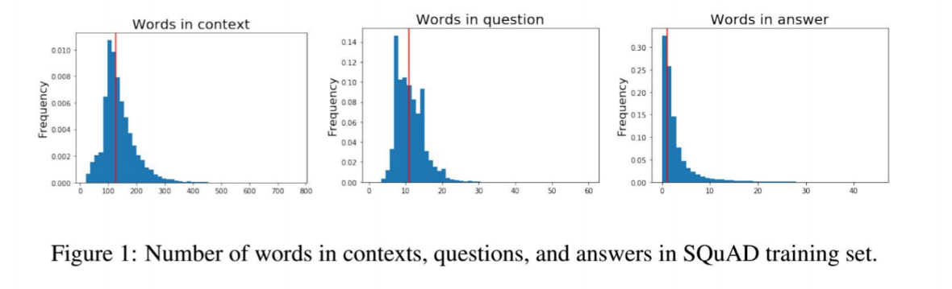
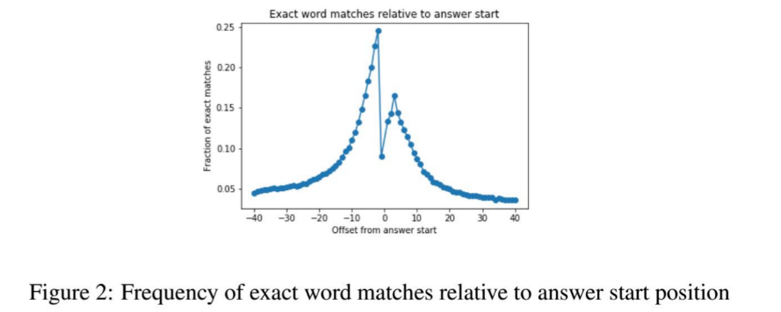
What about Long sequences?
The challenge illustrated with SQuAD
The impact of attention mechanism on Question Answering performance

Slide 42
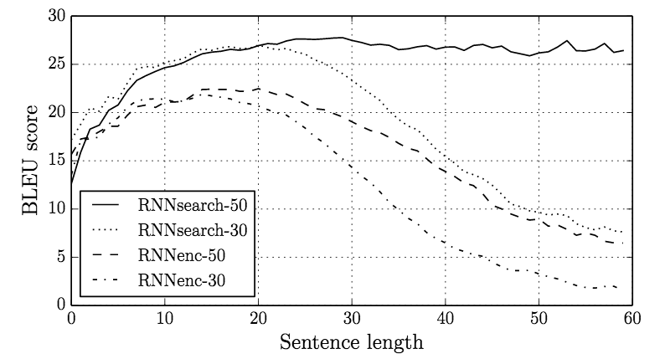
What about Long sequences?
The challenge
Bahdanau, D., Cho, K., & Bengio, Y. (2014). Neural machine translation by jointly learning to align and translate. arXiv preprint arXiv:1409.0473.

Slide 43
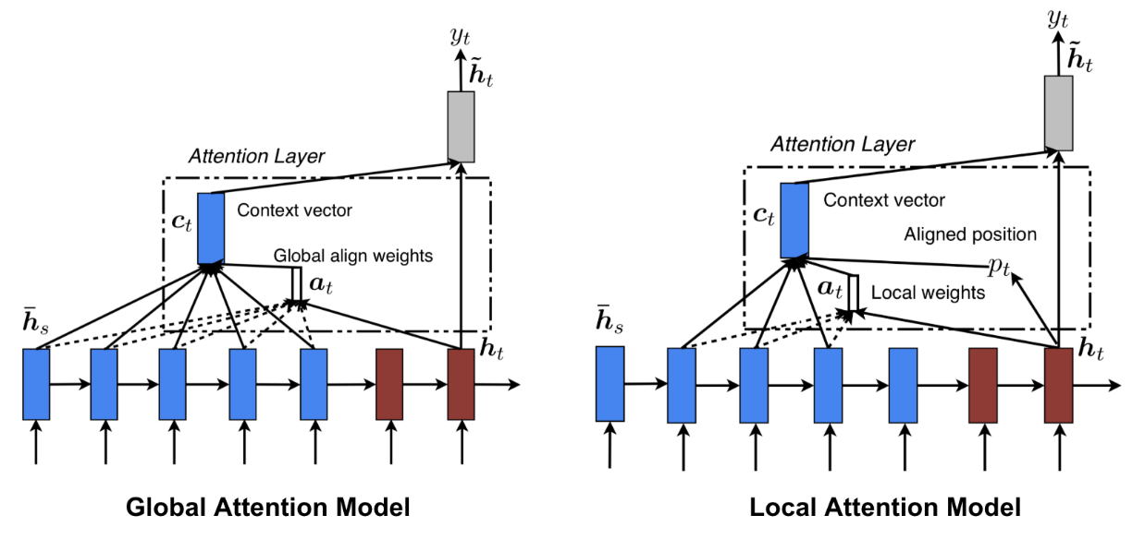
attention
The mechanism
Bahdanau, D., Cho, K., & Bengio, Y. (2014). Neural machine translation by jointly learning to align and translate. arXiv preprint arXiv:1409.0473.

Slide 44
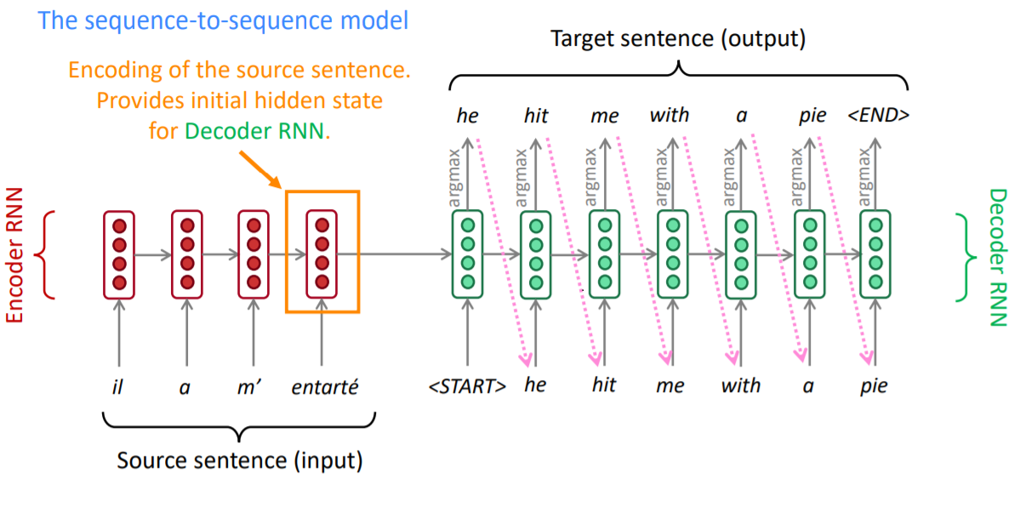
Encoder-Decoder
https://web.stanford.edu/class/archive/cs/cs224n/cs224n.1162/
Notes:
Encoder
Encoder reads the input sentence from the source language and encodes that information in vectors which are called hidden states.
We only take the hidden state of the last RNN and discard the encoder outputs.
Decoder
Decoder takes the hidden state of the last Encoder RNN cell as the initial state of its first RNN cell along with the <start> token as the
initial input to produce an output sequence.

Slide 45
Encoder-Decoder RNN Problems
The information from the encoder will become less and less relevant with every time step as
the encoder’s state is only passed to the first RNN cell of the decoder.

Slide 46
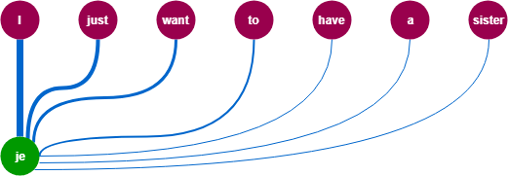
Attention Mechanism
most of the predicted words in the target sequence depend
on words after and before the corresponding word in the source sequence.

Slide 47
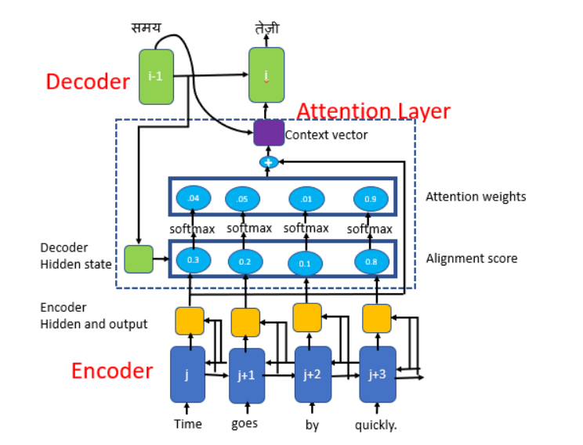
Bahdanau Attention Mechanism
Notes:
Bahdanau Attention is also known as Additive attention as it performs a linear combination of encoder states and the decoder states.
Pass all encoder hidden states to each step in the decoder
Notes:
FC = Fully connected (dense) layer,
EO = Encoder output,
H = hidden state,
X = input to the decoder.
score = FC(tanh(FC(EO) + FC(H)))*
attention weights = softmax(score, axis = 1). Softmax by default is applied on the last axis but here we want to apply it on the 1st axis, since the shape of score is (batch_size, max_length, hidden_size). Max_length is the length of our input. Since we are trying to assign a weight to each input, softmax should be applied on that axis.
* context vector = sum(attention weights
* EO, axis = 1). Same reason as above for choosing axis as 1.
* embedding output = The input to the decoder X is passed through an embedding layer.
* merged vector = concat(embedding output, context vector)

Slide 48
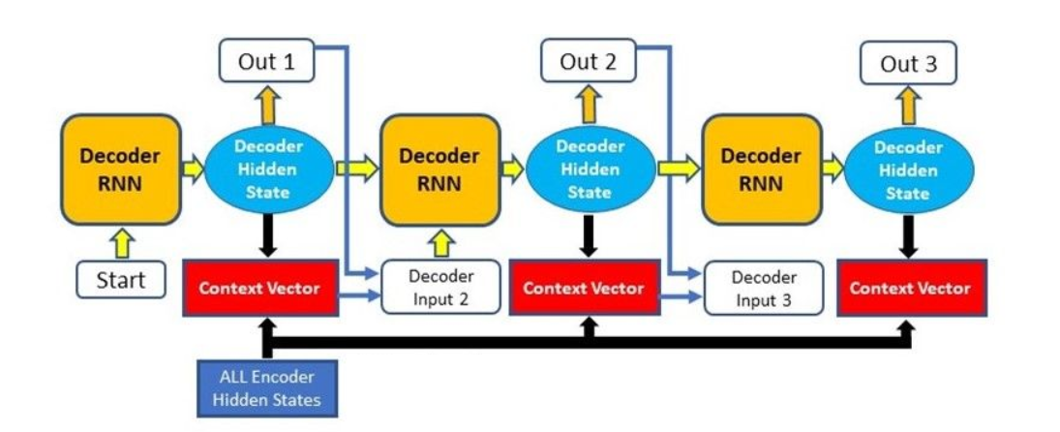
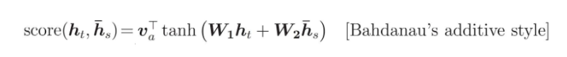
Bahdanau Attention Mechanism – Calc Alignment Score
Notes:
Alignment scores calculated between the previous decoder hidden state and each of the encoder’s hidden states.
The alignment scores for each encoder hidden state are combined and represented in a single vector and then softmax-ed.

Slide 49
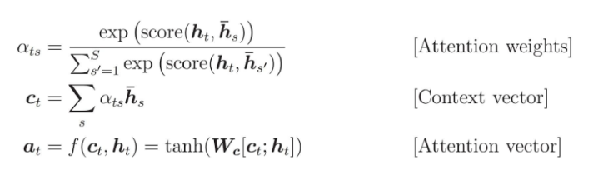
Bahdanau Attention Mechanism – Calc Context Vector
Notes:
. The encoder hidden states and their respective alignment scores (attention weights in the above equation)are multiplied to form the context vector. The context vector is used to compute the final output of the decoder.
The context vector that is obtained in the previous step is concatenated with the previous decoder output and fed into the Decoder RNN cell to produce a new hidden state.

Slide 50
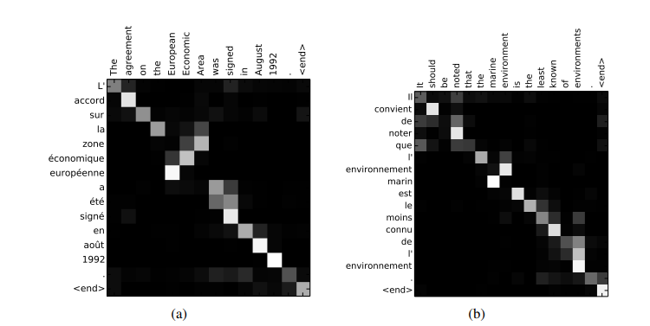
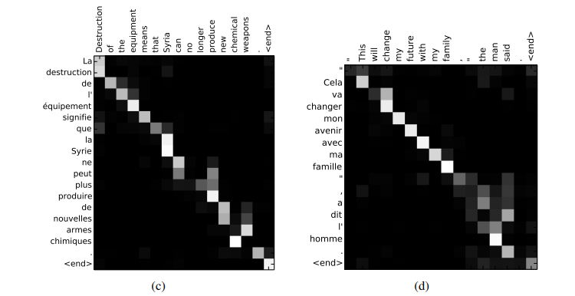
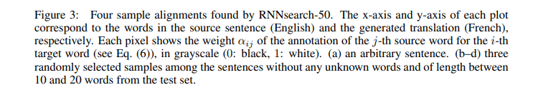
attention
The mechanism
Bahdanau, D., Cho, K., & Bengio, Y. (2014). Neural machine translation by jointly learning to align and translate. arXiv preprint arXiv:1409.0473.

Slide 51
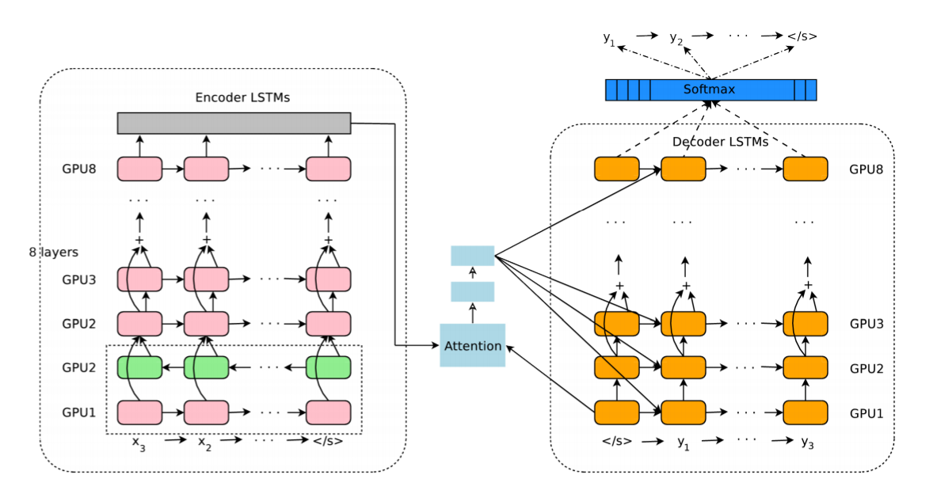
attention
Examples
Wu, Y., Schuster, M., Chen, Z., Le, Q. V., Norouzi, M., Macherey, W., ... & Klingner, J. (2016). Google's neural machine translation system: Bridging the gap between human and machine translation. arXiv preprint arXiv:1609.08144.

Slide 52
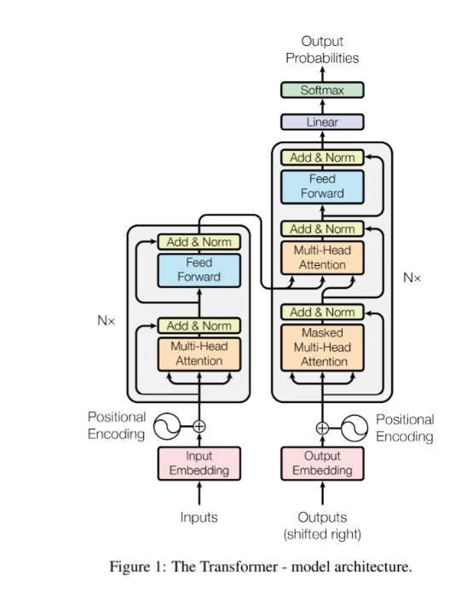
Attention is all you need
Design
Vaswani, A., Shazeer, N., Parmar, N., Uszkoreit, J., Jones, L., Gomez, A. N., ... & Polosukhin, I. (2017). Attention is all you need. In Advances in neural information processing systems (pp. 5998-6008).

Slide 53
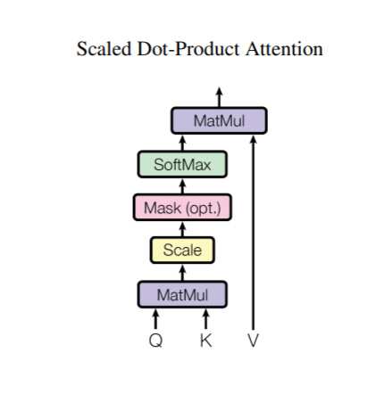
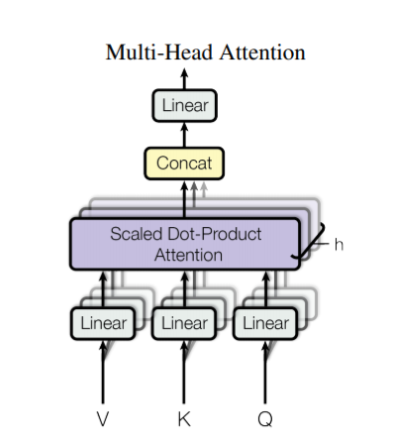
Attention is all you need
Design
Vaswani, A., Shazeer, N., Parmar, N., Uszkoreit, J., Jones, L., Gomez, A. N., ... & Polosukhin, I. (2017). Attention is all you need. In Advances in neural information processing systems (pp. 5998-6008).

Slide 54
Was it a breakthrough in itself?
Notes:
To put it in perspective

Slide 55
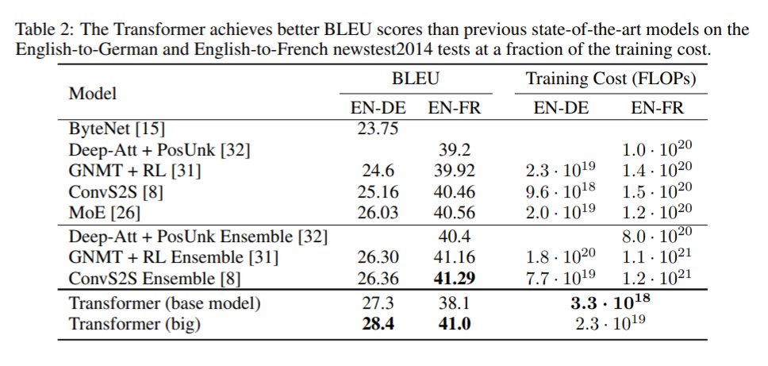
Attention is all you need
Not a breakthrough in itself
Vaswani, A., Shazeer, N., Parmar, N., Uszkoreit, J., Jones, L., Gomez, A. N., ... & Polosukhin, I. (2017). Attention is all you need. In Advances in neural information processing systems (pp. 5998-6008).

Slide 56
Attention is all you need
But …
“ … the Transformer can be trained significantly faster than architectures based on recurrent or convolutional layers.”
Vaswani, A., Shazeer, N., Parmar, N., Uszkoreit, J., Jones, L., Gomez, A. N., ... & Polosukhin, I. (2017). Attention is all you need. In Advances in neural information processing systems (pp. 5998-6008).

Slide 57
Neural Embeddings
Notes:
To put it in perspective

Slide 58
feature reuse
The opportunity

Slide 59
It was difficult to reuse NLP embeddings
Notes:
To put it in perspective

Slide 60
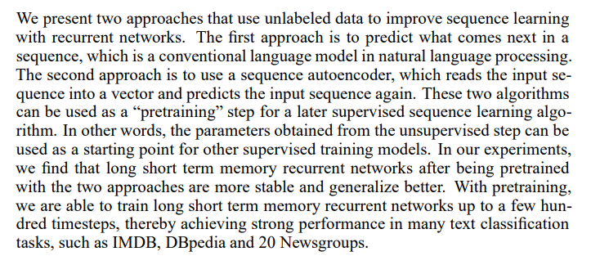
Semi-Supervised Sequence Learning
More complex representations
Dai, A. M., & Le, Q. V. (2015). Semi-supervised sequence learning. In Advances in neural information processing systems (pp. 3079-3087).

Slide 61
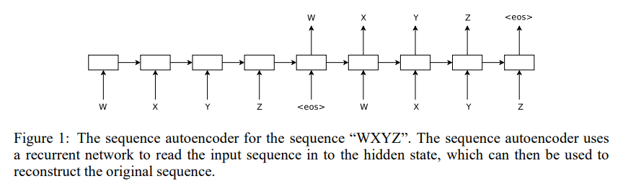
Semi-Supervised Sequence Learning
More complex representations
Dai, A. M., & Le, Q. V. (2015). Semi-supervised sequence learning. In Advances in neural information processing systems (pp. 3079-3087).

Slide 62
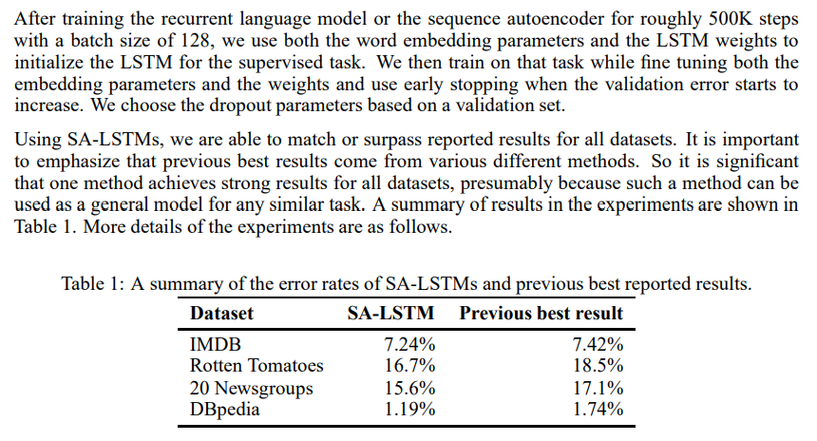
Semi-Supervised Sequence Learning
More complex representations
Dai, A. M., & Le, Q. V. (2015). Semi-supervised sequence learning. In Advances in neural information processing systems (pp. 3079-3087).

Slide 63
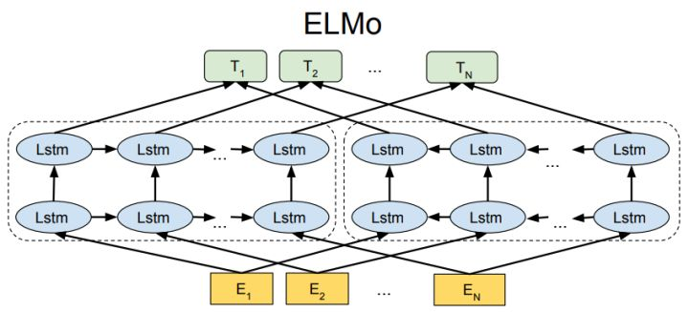
ELMo
Embeddings for Language Models
Peters, M. E., Neumann, M., Iyyer, M., Gardner, M., Clark, C., Lee, K., & Zettlemoyer, L. (2018). Deep contextualized word representations. arXiv preprint arXiv:1802.05365.

Slide 64
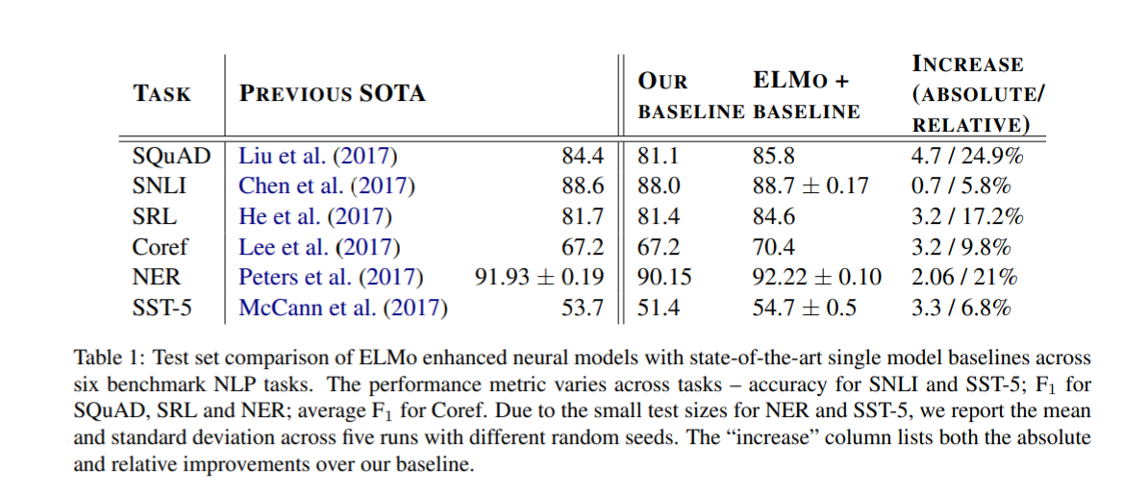
ELMo
Embeddings for Language Models
Peters, M. E., Neumann, M., Iyyer, M., Gardner, M., Clark, C., Lee, K., & Zettlemoyer, L. (2018). Deep contextualized word representations. arXiv preprint arXiv:1802.05365.

Slide 65
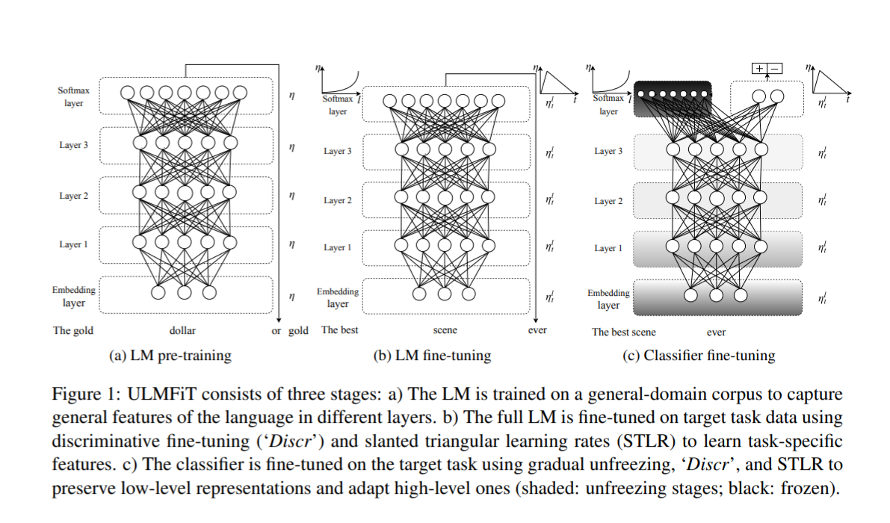
ULM-Fit
Universal Language Model Fine-Tuning for Text Classification
Howard, J., & Ruder, S. (2018). Universal language model fine-tuning for text classification. arXiv preprint arXiv:1801.06146.

Slide 66
Transfer Learning in NLP
Not trivial to use and not universally applicable
Howard, J., & Ruder, S. (2018). Universal language model fine-tuning for text classification. arXiv preprint arXiv:1801.06146.
Peters, M. E., Neumann, M., Iyyer, M., Gardner, M., Clark, C., Lee, K., & Zettlemoyer, L. (2018). Deep contextualized word representations. arXiv preprint arXiv:1802.05365.
1957
1988
2010
2013/
2014
2018
Distributional
Hypothesis
LSA / LSI
The use of unsupervised
embeddings
Success of NN
First successes in
transfer learning

Slide 67
This Created a foundation for the new NLP Models (discussed in the next class)
Notes:
To put it in perspective

Slide 68
The Lab
Notes:
To put it in perspective

Slide 69
Attention is all you need
Deep dive into the transformer design
Vaswani, A., Shazeer, N., Parmar, N., Uszkoreit, J., Jones, L., Gomez, A. N., ... & Polosukhin, I. (2017). Attention is all you need. In Advances in neural information processing systems (pp. 5998-6008).

Slide 70
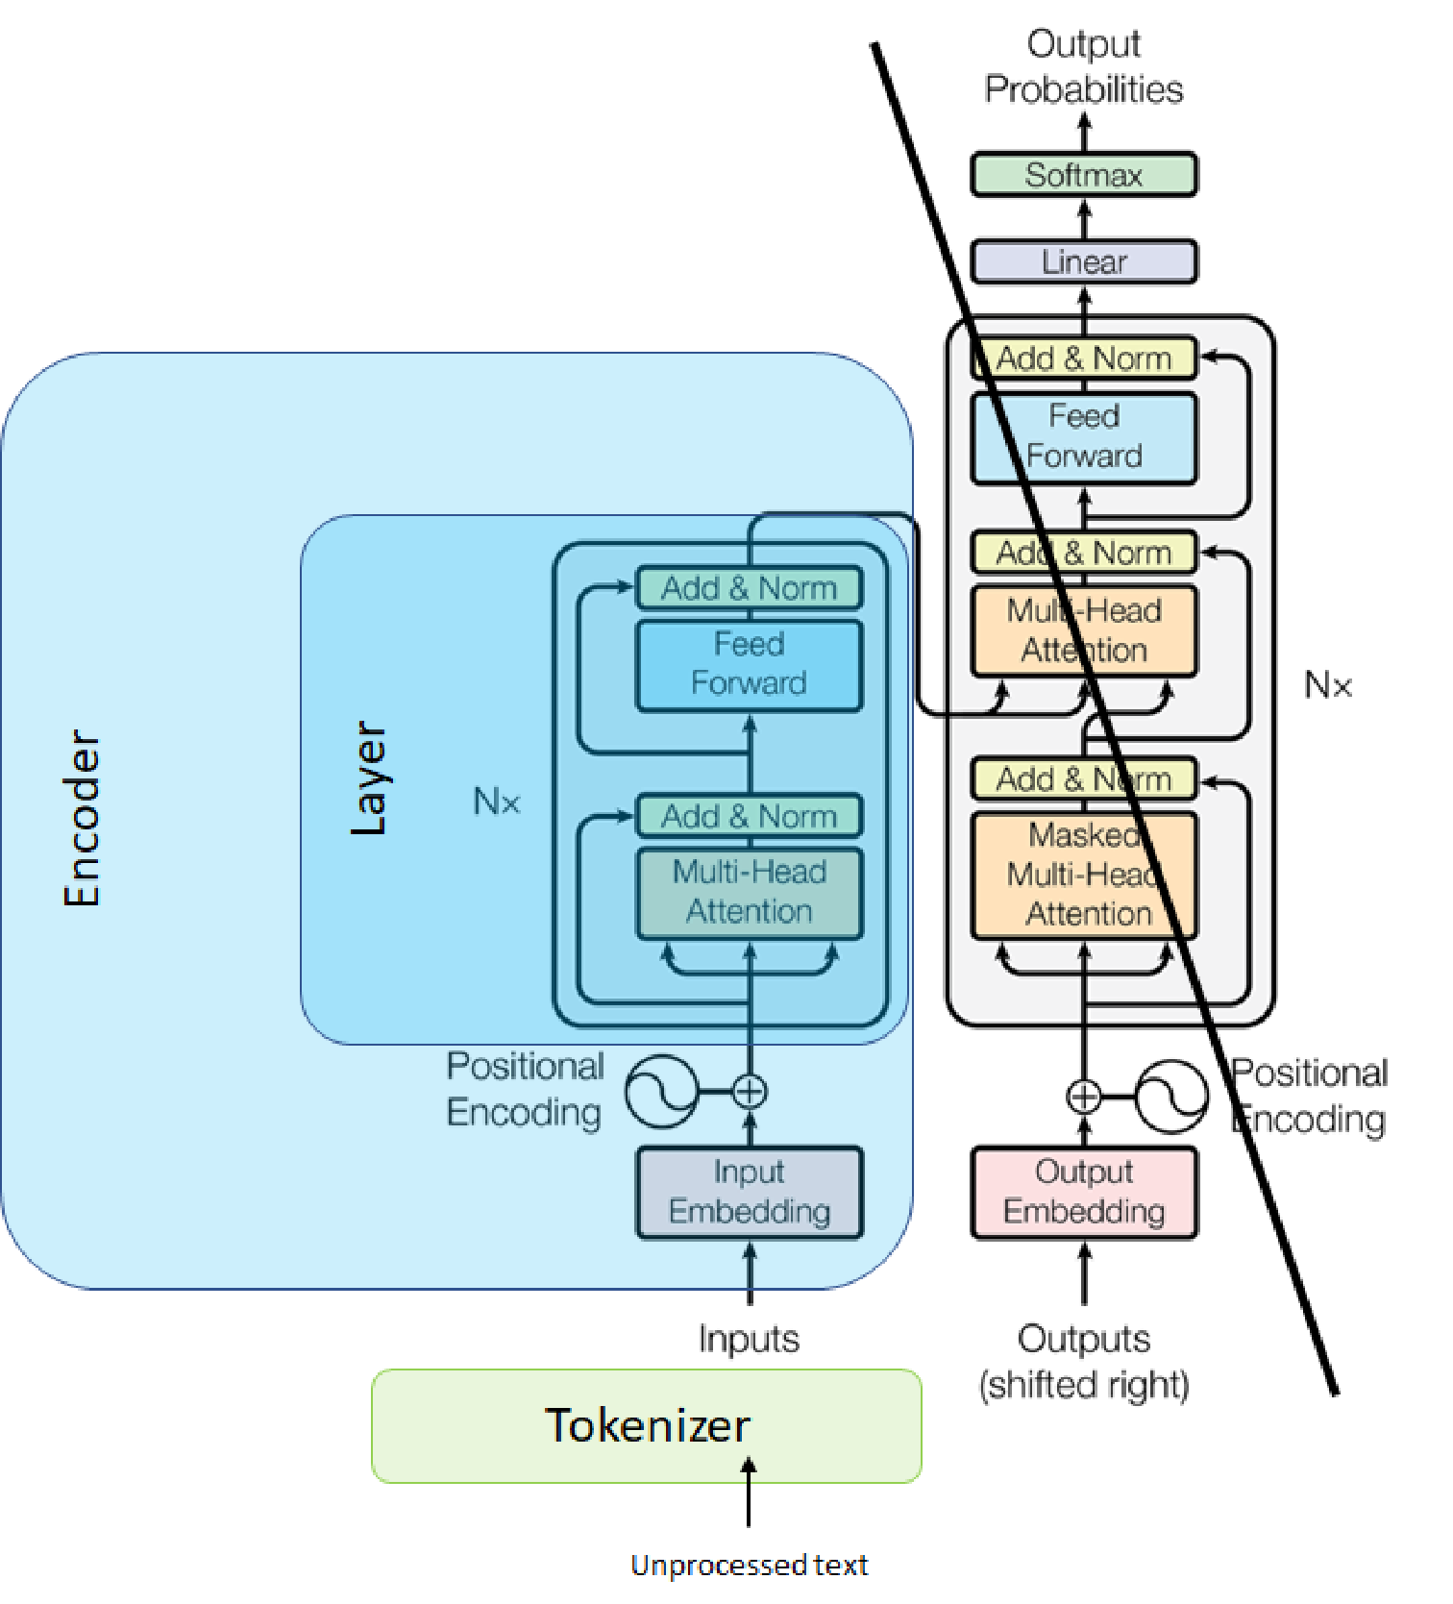
Bert
How it relates to transformer and pretraining

Slide 71
In The Next Class…
Notes:
To put it in perspective

Slide 72
Self-supervision, BERT, and beyond
Why did models start to work well? What does the future hold?
?

